Slide 1
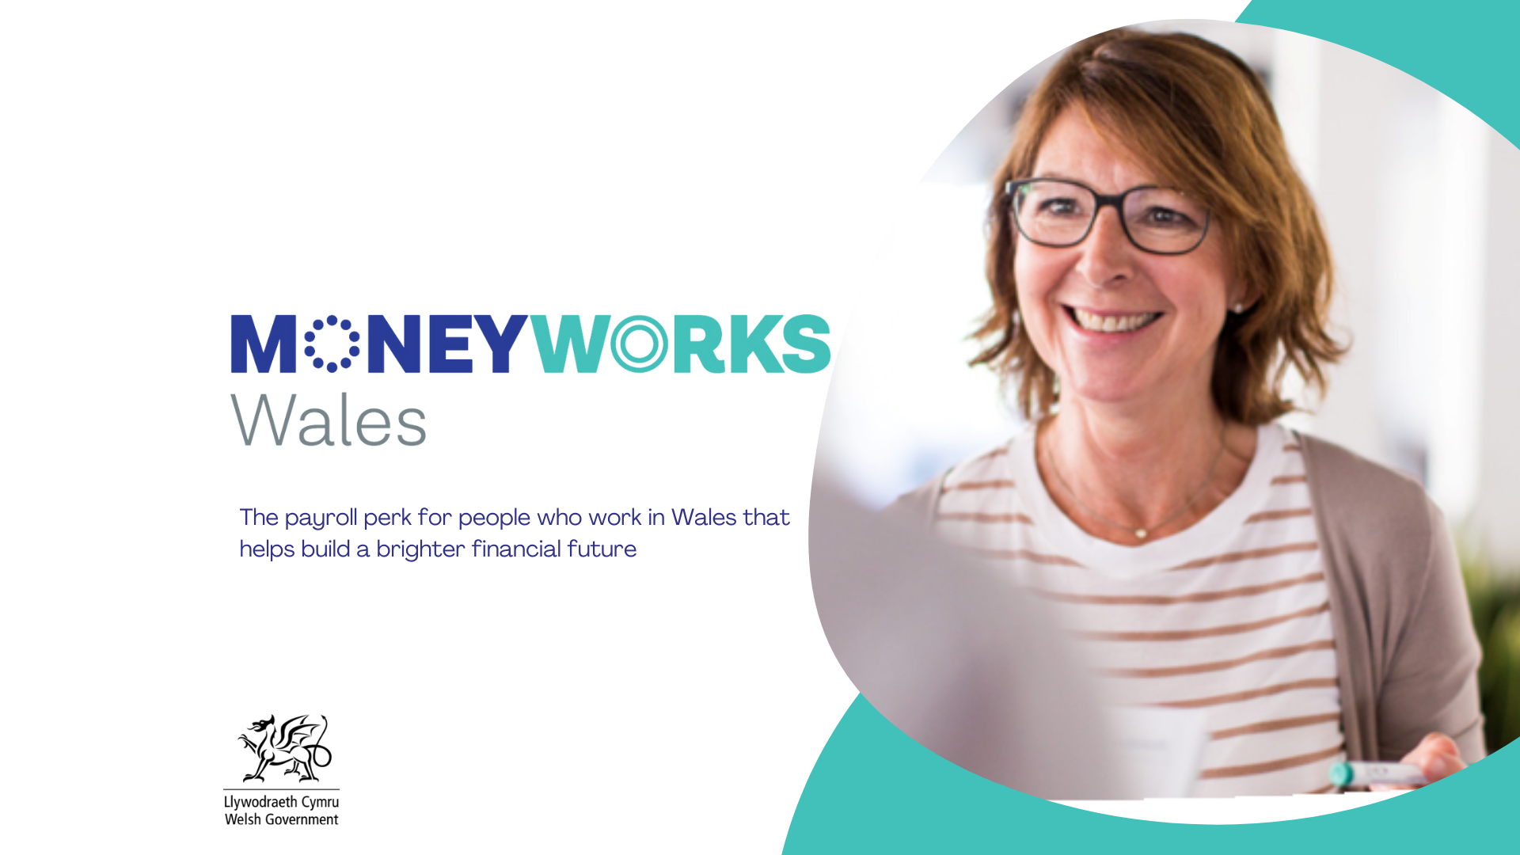

Slide 2

What is a Credit Union?
Member owned financial co-operatives
Providing savings and affordable loans
Not-for-profit
Promoting financial health of members
FCA/PRA regulated and member savings protected
Providing services in partnership with schools, local authorities etc.

Slide 3
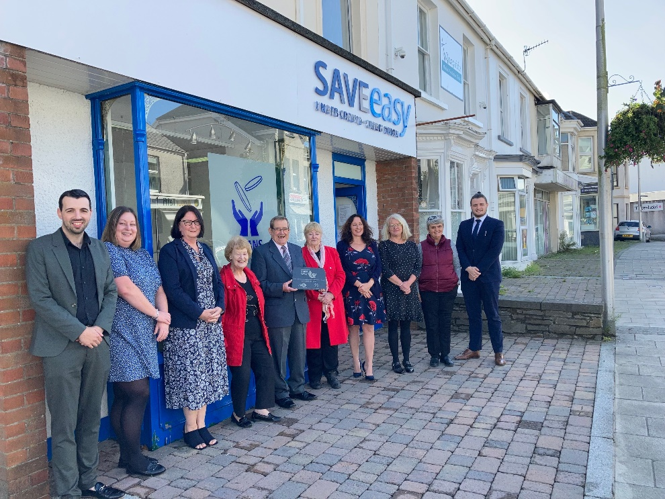
How Does a Credit Union Work?
Members save
Loans to members
Interest from loans pays generates surplus
Minus running costs
Excess surplus = dividend to members

Slide 4
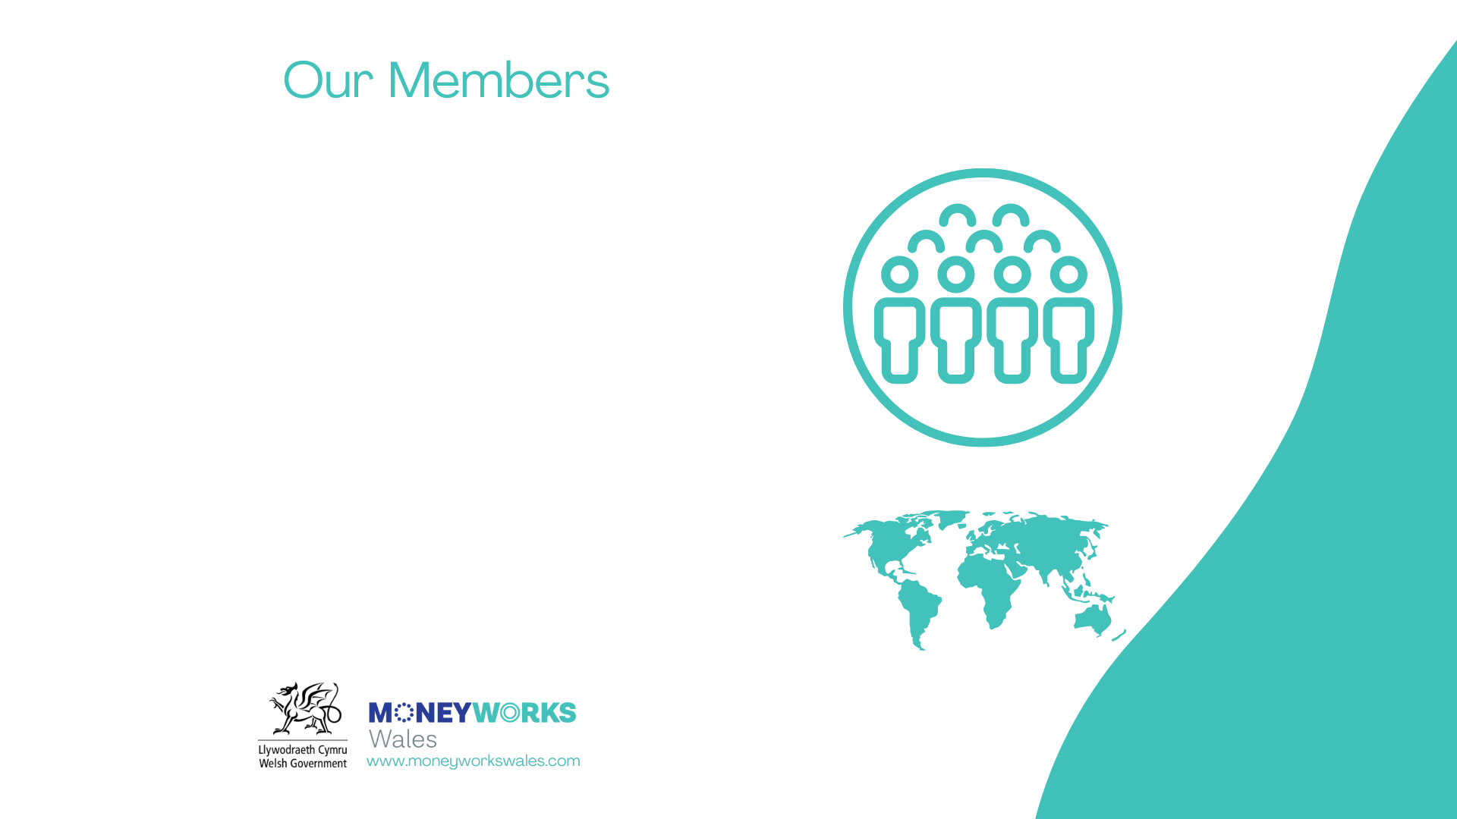


Currently circa 82,000 people in Wales are members of a credit union
Combined savings of £52m
Loans of £24.6m
Globally 217m people are credit union members
Members are our only shareholders

Slide 5
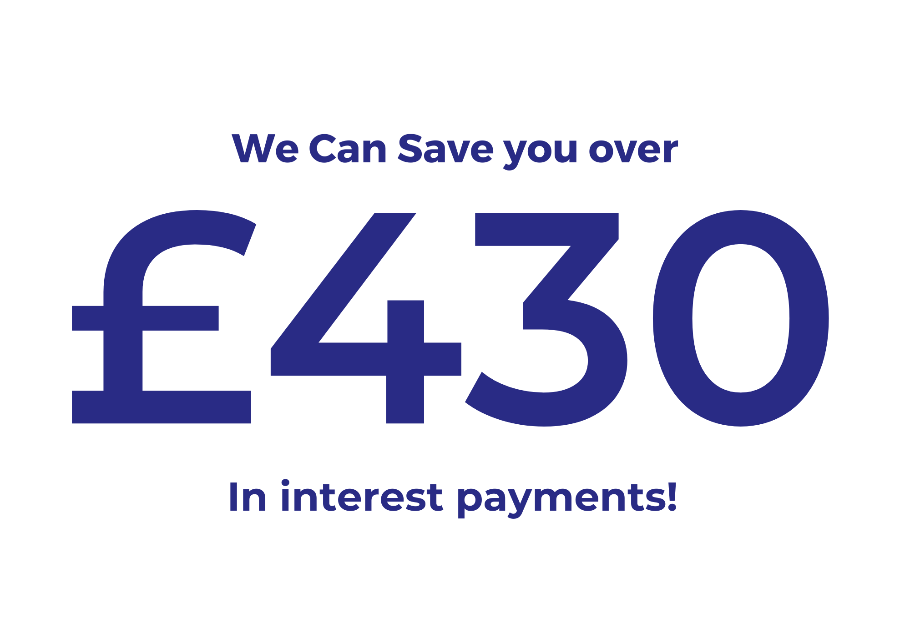

Slide 6
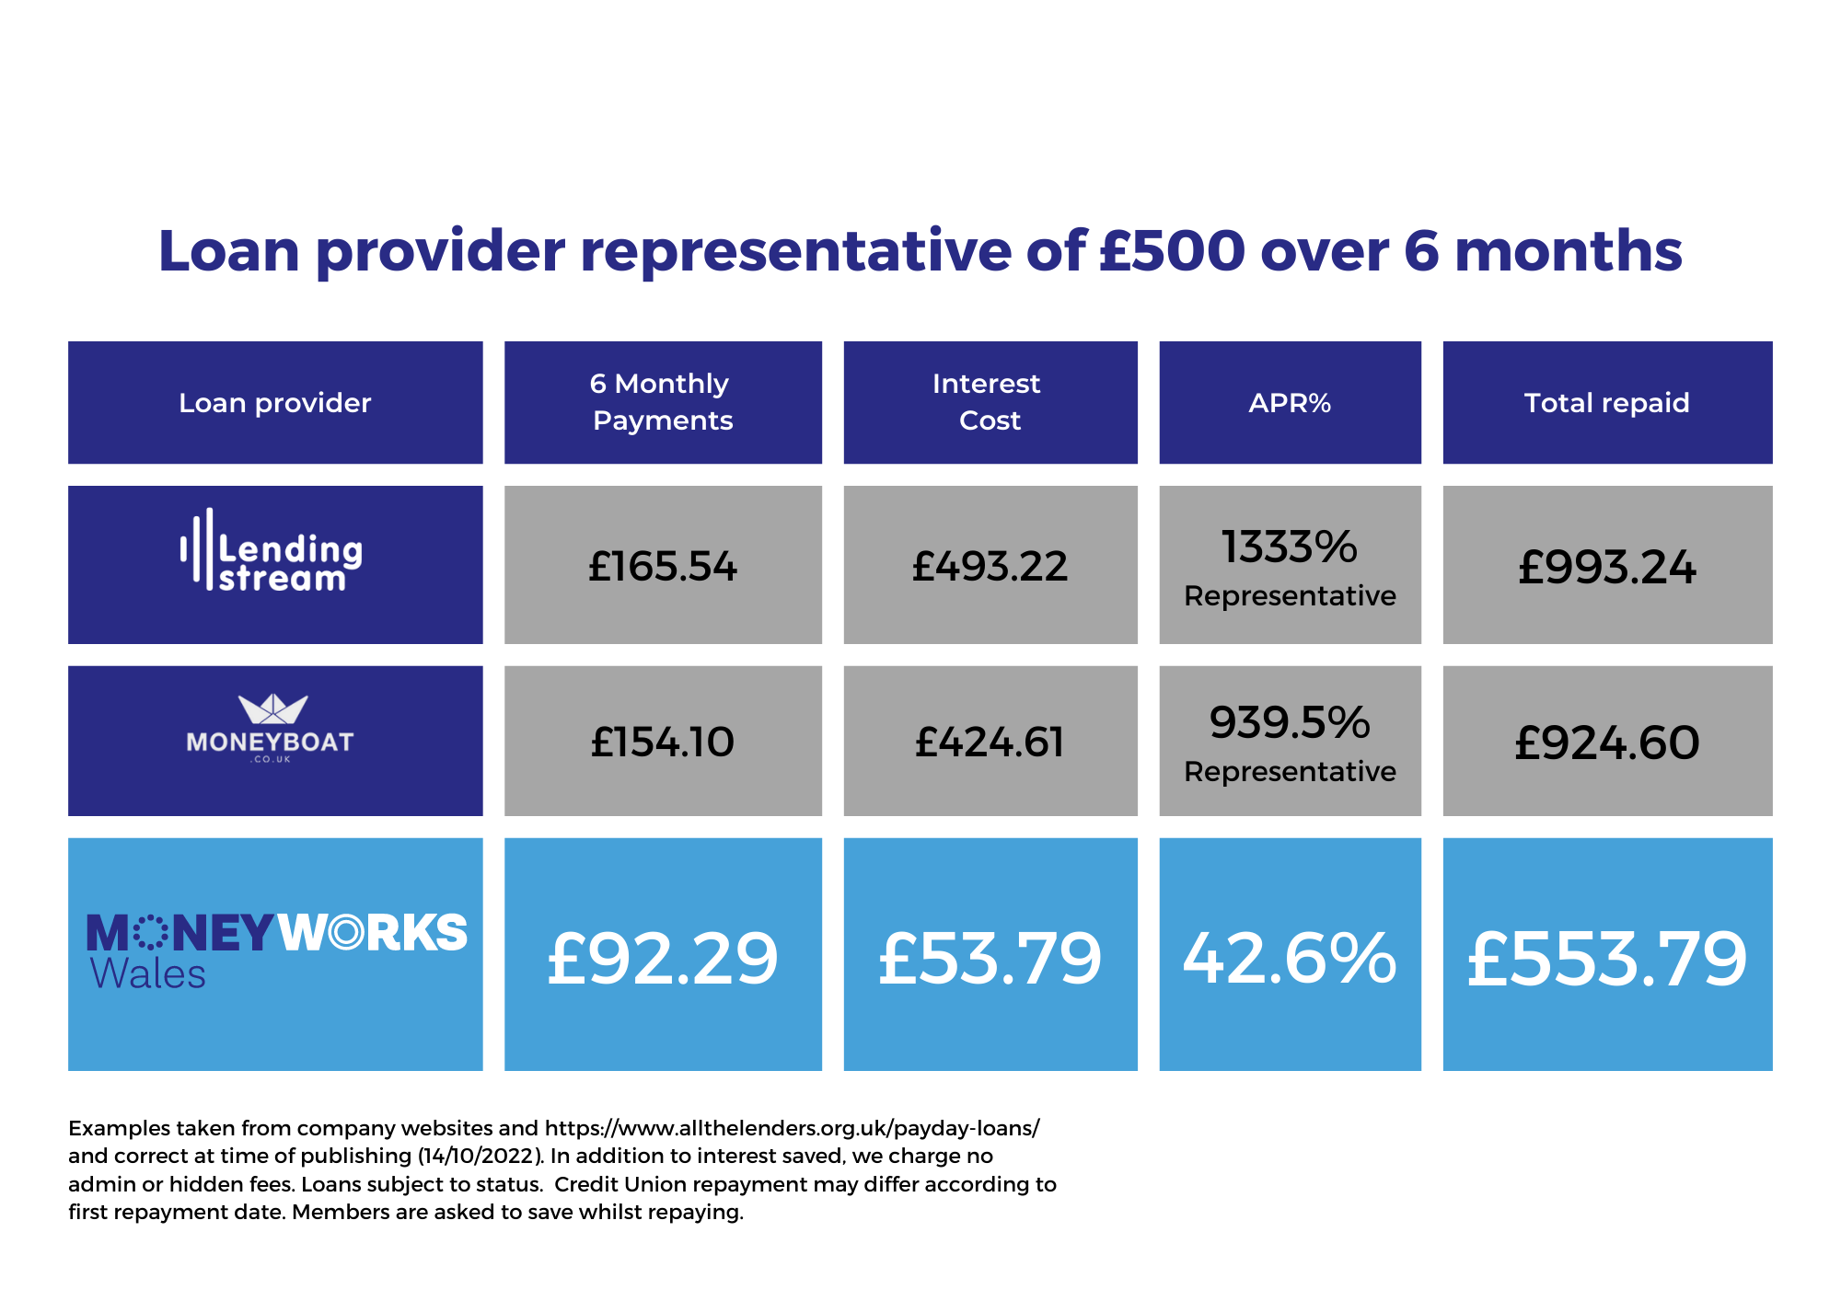

Slide 7


Why borrow from a loan shark?
Text message to loan shark from a single mother in Swansea:
“Any chance u can lend me 25, dan has sports day tomorrow he needs packed lunch and new socks and trainers please text me to let me know either way thanks really desperate.”

Slide 8
Why borrow from a loan shark?
Before COVID-19, 200,000 people borrowed from unlicenced money lenders or loan sharks (unchanged since 2017), but this had risen to an estimated 1.08m by late 2021
Money and Pensions Service
July 2022

Slide 9
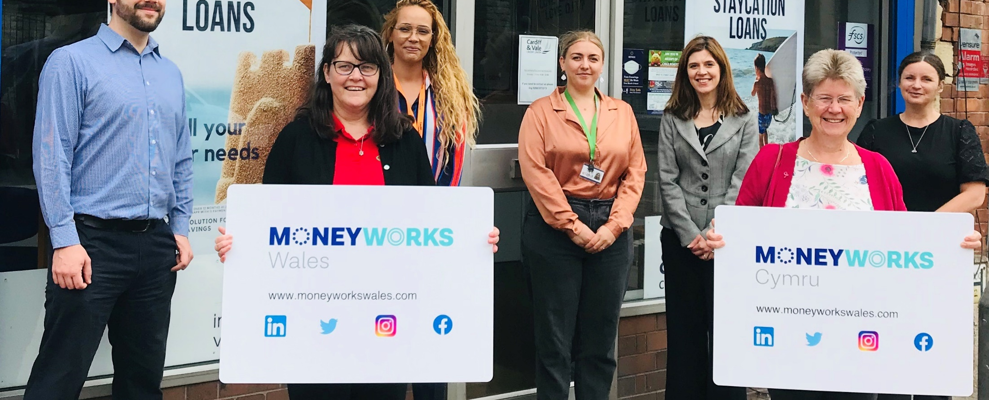
Moneyworks Wales is a collaboration between Wales’ leading financial co-operatives.
Support from Welsh Government and TUC Cymru with 150+ employer partners.
We are 8 credit unions committed to improving the financial wellbeing of Welsh workers.
Regulated by the PRA and FCA, your savings are guaranteed up to £85,000 through the Financial Services Compensation Scheme, just as they would be with a bank or building society.

Slide 10
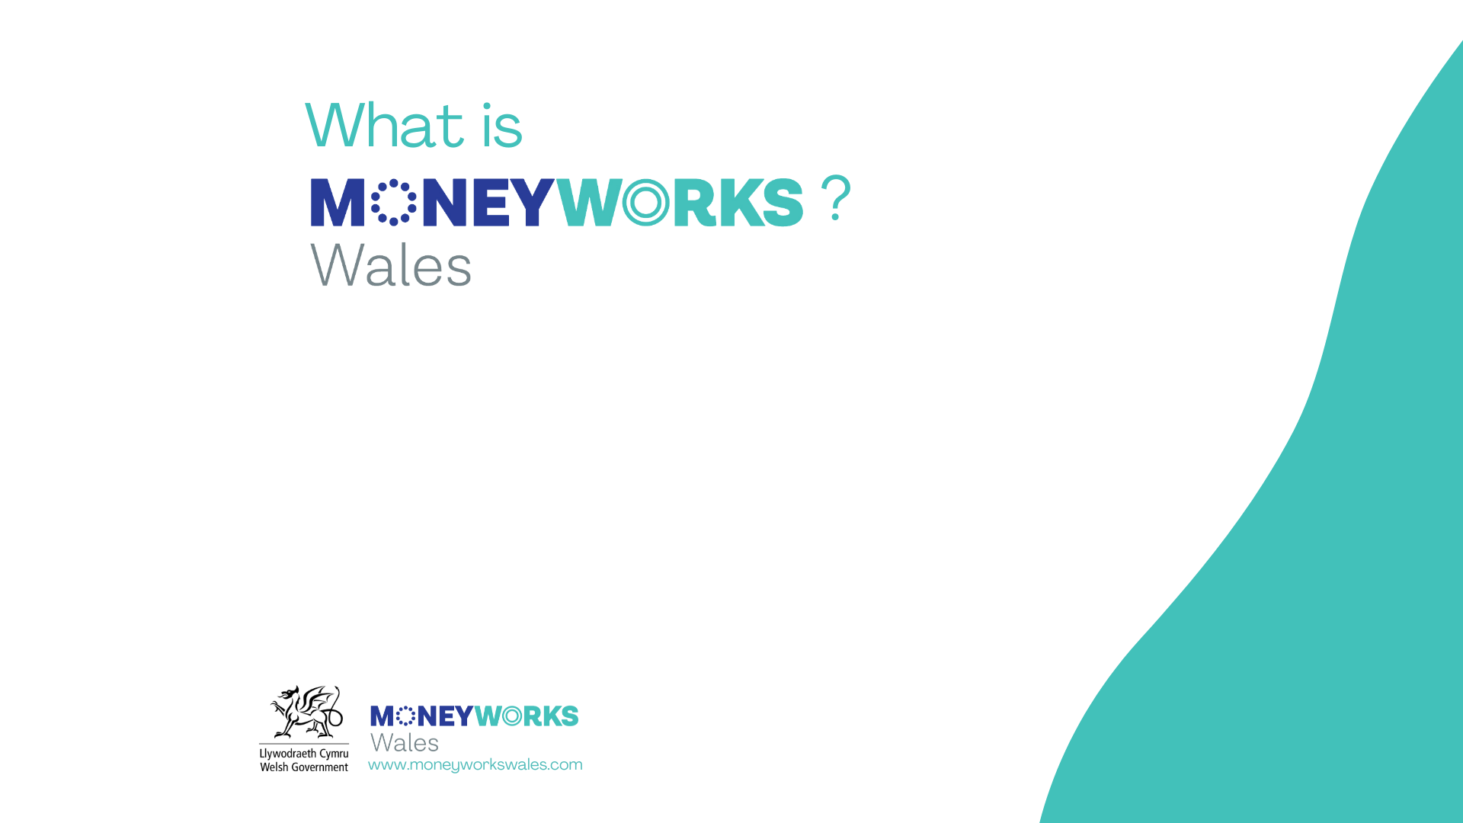
Save or borrow direct from your salary.
Save: Decide how much you want to save, it will be deducted (like pension or union deductions) at source and put in your savings account.
Borrow: Apply for a loan and make payments direct from your salary, never missing a payment, so good for your credit score.
HR/ payroll will not know whether the deduction is for savings or loan repayment.

Slide 11
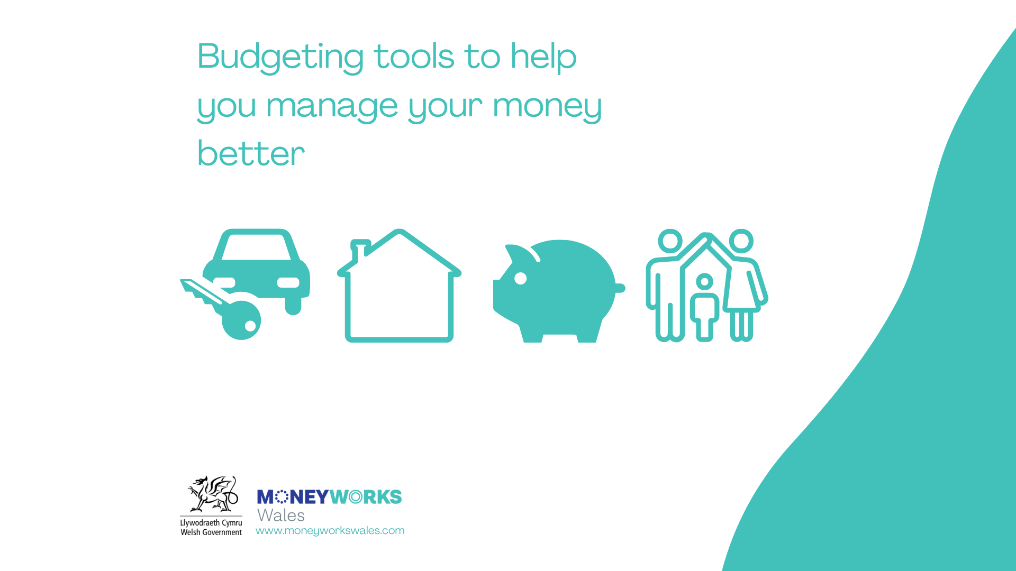
Check out the budgeting tools at www.moneyworkswales.com
Buying a new car
Buying a new home
Working out your pension
New addition to the family

Slide 12
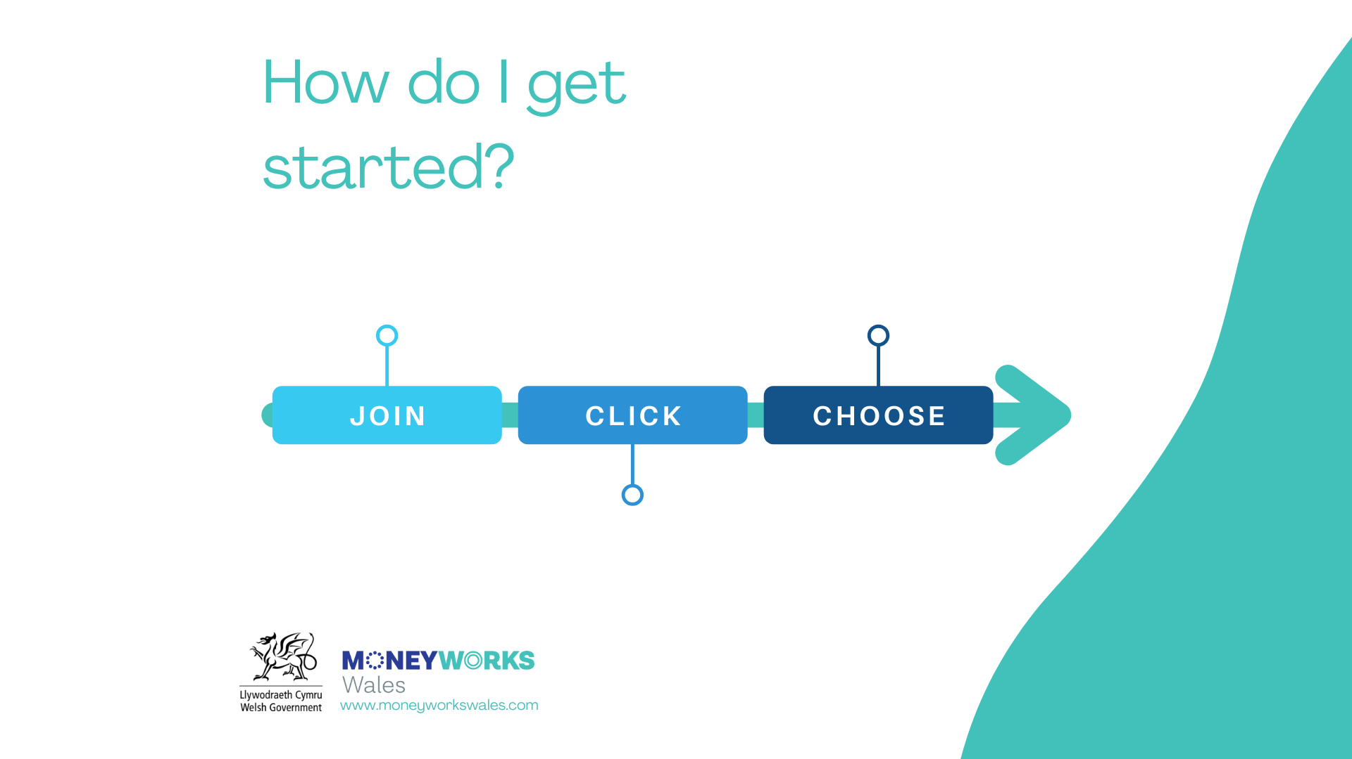
Join online at moneworkswales.com
Choose your employer from the dropdown list
Click on the Save or Borrow button

Slide 13

Employee Benefits
Ease and convenience of saving regularly
Affordable and responsible lending
Encourages wider financial health
Keeps money in our communities
Annual dividends to members (subject to performance)
Life insurance on savings (where eligible)
Savings protected by FSCS
For our members - not for profit

Slide 14
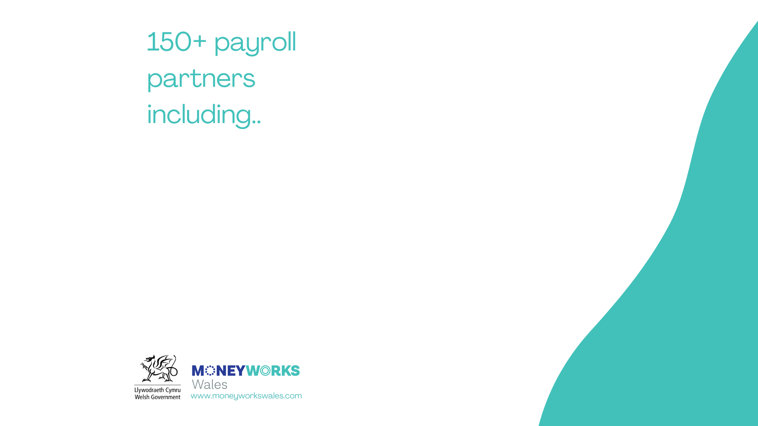








+ Housing Associations
+ Local Authorities
+ Private Sector

Slide 15

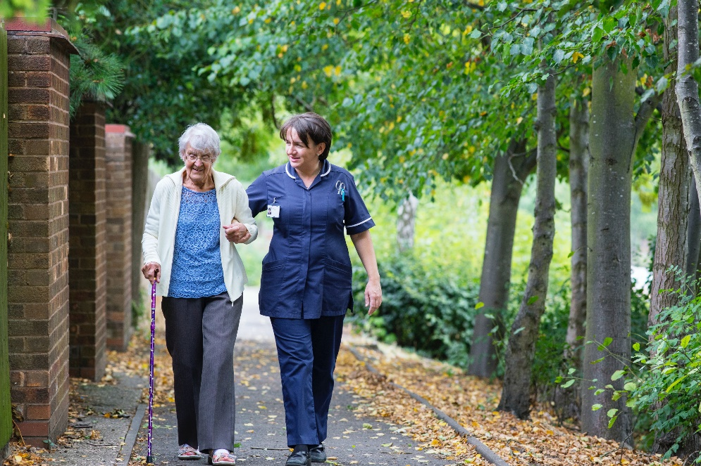
"I used to find it so difficult to save, but the credit union lets you save while you're paying off a loan. That motivated me to save more. I would recommend this to anyone that struggles with money and to save.”
“When I didn’t know what to do, just a small loan with reasonable terms and conditions and manageable interest rates helped me so much.”
“Allows me to make my repayments through my wages so I don’t have to worry about ever missing a payment, while also saving up with each repayment as well. Also, I know each time I pay back to credit union goes back into a pot so other members can borrow.”

Slide 16
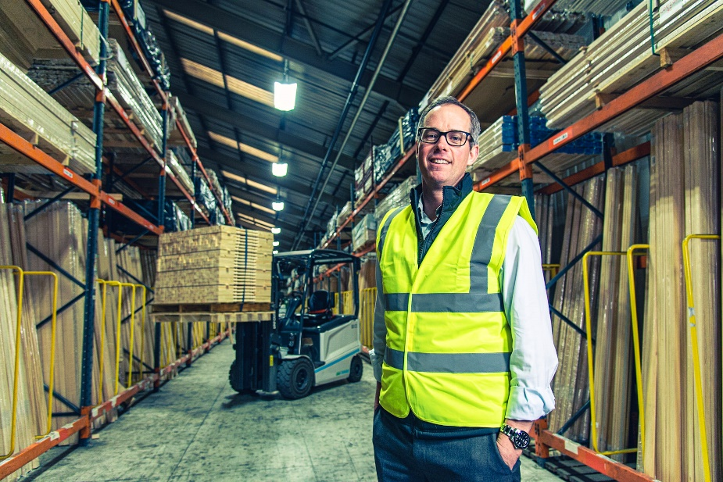
Employer Benefits
A unique employer perk
Free to employers
Benefits staff and the community
Part of financial wellbeing package
Encourages positive financial habits
No liability other than BACS payment transfers and corresponding details
For our members - not for profit

Slide 17


Slide 18
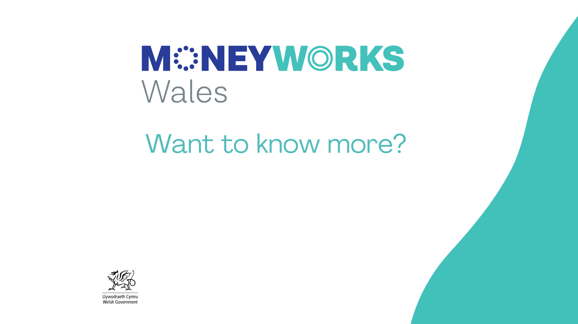
Contacts: Sandy Highfield/ Rizwan Shams
Email: enquiries@moneyworkswales.com
Web: www.moneyworkswales.com
Web: www.creditunionsofwales.co.uk

