Slide 1
Financial Support from UNISON - Your Union
Richard Speight
Area Learning Development Organiser
UNISON Cymru Wales

Slide 2
We shouldn’t have to do this…
…but we have to do this!

Slide 3
Working together collectively
“…by the strength of our common endeavour we achieve more than we achieve alone, so as to create for each of us the means to realise our true potential...”
Our movement is built on the idea of collective self-help
The union is here because of its members and for the benefit of its members
Financial support is there for YOU and your colleagues

Slide 4
The aim of this talk is to:
Tell you about the financial support available to you as a UNISON member
To look at some of the membership benefits and offers that might help
Signpost you to the campaigns we’re running that will help address the underlying causes of the crisis
Notes:
Talk through the aims of the course as outlined on the slide.

Slide 5
Your input!
Join the union if you’re not a member, if you are a member, recruit a colleague!
Click the links I share, then share them with your colleagues
Ask questions using the chat
Share ideas, links and resources
Get involved in UNISON campaigns

Slide 6
Our welfare service… UNISON There For You
FINANCIAL ASSISTANCE – Means tested hardship grants for members, partners and dependents
There for You is proud to support thousands of members and their families every year with things such as:
General living costs
household appliances
urgent repairs
disability equipment and adaptations
utility bills
funeral costs.
Your UNISON branch can help you complete the application form.

Slide 7
Our welfare service… UNISON There For You
UNISON Debtline
0800 389 3302
UNISON Debtline can help you deal with all sorts of debt, from credit cards, to mortgage arrears, to county court judgment claims.
We can help give you the best chance of keeping your home if you’re at risk of repossession.
immediate advice
a free and confidential service with no hidden charges
a personal case officer to advise you and negotiate with your creditors
a manageable debt plan to suit your circumstances
Notes:
To introduce the group to each other, ask everyone to introduce themselves and to say something about their role in the branch (that they are happy to share with the group).

Slide 8
Our welfare service… UNISON There For You
Other Grants
Energy Support Fund – Phase 2 launches 16 November - £200 means tested
Winter Fuel Grant – Launching in January 2023
School Clothing Grant – Summer 2023 - £70 per child in 2022 means tested
Various learning Grants…
Notes:
To introduce the group to each other, ask everyone to introduce themselves and to say something about their role in the branch (that they are happy to share with the group).

Slide 9
Our welfare service… UNISON There For You
Online Tools
UNISON Benefits Calculator
UNISON Budget Planner
UNISON Cost of Living Calculator

Slide 10
UNISON Learning Grants
Member Learning Grants
To help members studying at levels up to and including undergraduate at their own expense on the following types of courses:
Trade Union and Labour Studies (where an applicant has not received a bursary)
non-vocational education up to and including undergraduate level
vocational education relevant to public service work up to and including undergraduate level
DEADLINE: Friday 21st October 2022 learning.unison.org.uk/financial-support/
OU Study Grant
- available to UNISON members undertaking 30 and 60 point Open University courses up to and including undergraduate level at their own expense.
learning.unison.org.uk/financial-support/
WULF Grant for Qualifications
- Grants from our Wales Union Learning Fund project to help towards accredited learning up to Level 4, available up to March 2025
cymru-wales.unison.org.uk/learning

Slide 11
UNISON Member Benefits Welfare Breaks - If you are on a low income or in hardship and cannot afford the cost of a break
Get Well day out or short break
Illness that has prevented your attendance at work for at least 3 months and are still be off work or on a phased return at the time the break is taken.
If you are suffering the ongoing effects of post-traumatic stress disorder or long COVID which has seriously impacted your health and income
If you have been diagnosed with a serious illness in the last 12 months
If you are currently struggling to stay in-work and diagnosed with a mental health condition in the last 12 months.
Breaks in special circumstances
Break of up to one week in exceptional circumstances.
Respite break
Day out or short break for carers in receipt of Carer’s Allowance and who are responsible for a disabled dependent. Alternatively, consideration may be given to one-off funding for recreational activities e.g. yoga classes, art, stress management etc.
Bereavement
Family break where there are children in education who have lost a parent within the last 12 months and where the deceased is the member, the member’s partner or child’s legal guardian.
Where a parent has lost a child in the last 12 months.

Slide 12
UNISON Member Benefits Member discounts
Discounts & cashback with a range of online retailers www.unisonrewards.com including Energy https://www.unisonrewards.com/brands/gas-and-electricity
Motor Insurance & Breakdown, Home Insurance, Health & Dental
Holidays, Travel Club, Croyde Bay Resport in Devon
Lighthouse Financial Advice
benefits.unison.org.uk
Notes:
To introduce the group to each other, ask everyone to introduce themselves and to say something about their role in the branch (that they are happy to share with the group).

Slide 13
UNISON’s other activities
UNISON branch welfare officers
Foodbank referrals through branches
Links to local initiatives and organisations
Links to employer schemes
UNISON Financial Wellbeing Fortnight webinars
AND THIS EVENT!!!
Notes:
To introduce the group to each other, ask everyone to introduce themselves and to say something about their role in the branch (that they are happy to share with the group).

Slide 14
Cost of Living Campaign Resources
The solution to the crisis is better pay and conditions for workers
www.costofliving.unison.org.uk/
The Online Calculator

Slide 15
Talking to others
Our colleagues are worried about the future but together, in UNISON, we can help.
With our financial support and in our campaigns for better pay and conditions for workers, we can help turn:
Fear into anger
Despondency into hope
Apathy into action.
Notes:
Explain that in order to get a good turn out in the pay ballots, we will need to motivate and mobilise members to use their vote.
One way of having a conversation about the pay ballot is by using the Anger, Hope, Action model which helps to turn members fears about the future into hope – and turning apathy into action. Motivating members is where pay campaign contacts can help to make a real difference.

Slide 16
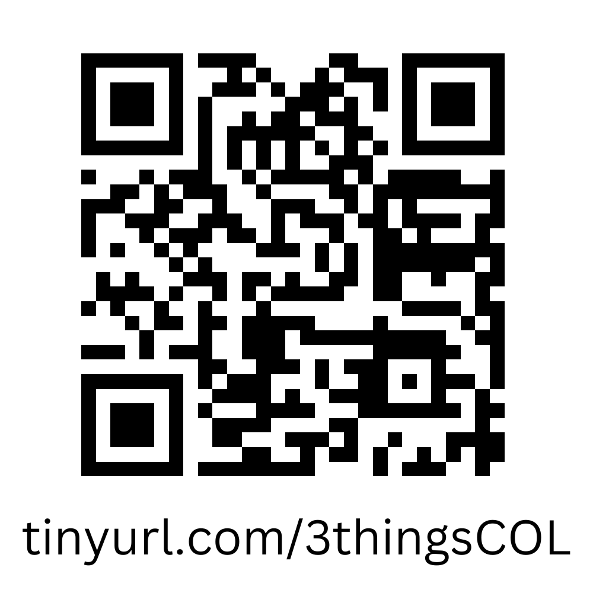
Next steps: getting ready for action!
Identify 3 things that you are going to do with UNISON’s financial support for yourself.
Identify 3 things that you are going to do to help your colleagues and community.
Notes:
To close the workshop ask members to come up with 3 key actions that they are going to achieve in the next week and 3 actions that they are going to do within the next month to support or follow-up the pay campaign.
Signpost members to UNISON’s resources and learning pages.

Slide 17
Supporting UNISON campaigns
Share on Social Media
Talk to people at work and socially about what you learn today
Get involved in your branch as a workplace contact or rep
Contribute to the Energy Support Appeal (if you can)
VOTE!
Notes:
In break-out rooms, ask the members to identify some actions that they are going to put in place within the next few weeks to support the pay claim.
What will they need to do back in the branch? Who will they need to work with? When are they going to do it?

